Slide 1
Chapter 5 Finite Control Volume Analysis
CE30460 - Fluid Mechanics
Diogo Bolster

Slide 2
Objectives of this Chapter
Learn how to select an appropriate control volume
Understand and Apply the Continuity Equation
Calculate forces and torques associated with fluid flows using momentum equations
Apply energy equations to pipe and pump systems
Apply Kinetic Energy Coefficient

Slide 3
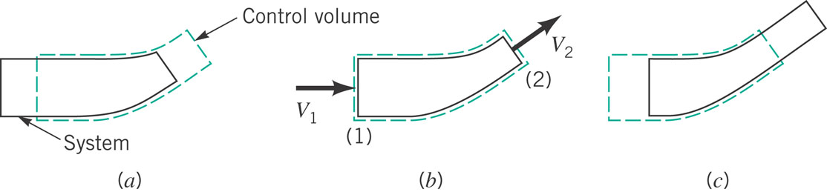
Recall System and Control Volume
Recall: A system is defined as a collection of unchanging contents
What does this mean for the rate of change of system mass?

Slide 4
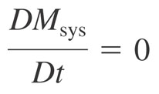
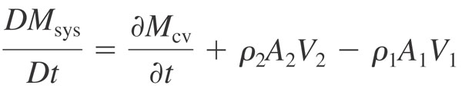
Recall Control Volume (CV)
Recall Reynolds Transport Theorem (end of last chapter)
Let’s look at control volumes on video

Slide 5
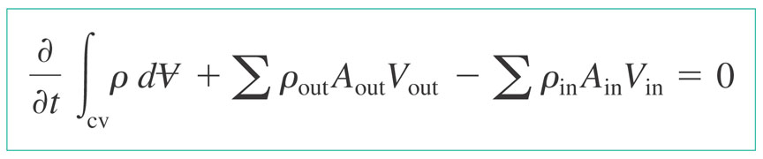
Conservation of Mass
Combining what we know about the system and the Reynolds Transport Theorem we can write down a equation for conservation of mass, often called ‘The Continuity Equation’
All it is saying is that the total amount of mass in the CV and how that changes depends on how much flows in and how much flows out …

Slide 6

Fixed Non Deforming CV
Examples

Slide 7
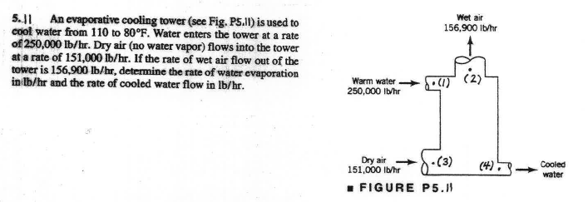
Sample Problem 1

Slide 8
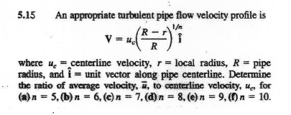
Sample Problem 2

Slide 9
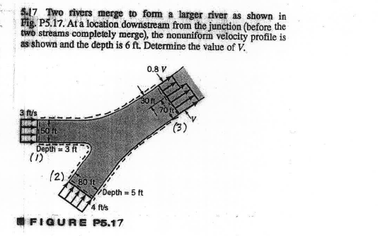
Sample Problem 3

Slide 10
Sample Problem 4
Consider a rectangular tank (2mx2m) of height 2m with a hole in the bottom of the tank of size (5cmx5cm) initially filled with water. Water flows through the hole
Calculate the height of the water level in the tank as it evolves in time
Assume the coefficient of contraction for the hole is equal to 0.6

Slide 11
Conservation of Mass
Videos and Pictures
Numbers 867, 882, 884, 885, 886, 889
Multimedia Fluid Mechanics (G.M. Homsy et al), Cambridge University Press

Slide 12

Moving CV
Example:
Bubbles rising: http://www.youtube.com/watch?v=dC55J2TJJYs

Slide 13
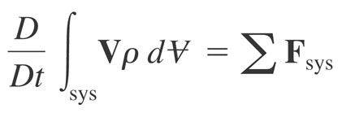
Conservation of Momentum
Newton’s Second Law
ΣF=ma
Or better said :
Time rate of change of momentum of the system=sum of external forces acting on the system
Again, we will apply the Reynolds Transport Theorem (write it out yourselves)

Slide 14
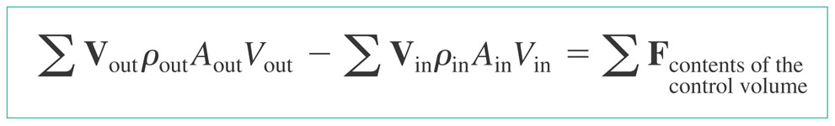
Conservation of Momentum
General Case
Steady Flow
Linear Momentum Equation

Slide 15
Relevant Examples
Fire Hose
http://www.youtube.com/watch?v=R8PQTR0vFaY&feature=related
http://www.break.com/index/firemen-lift-car-with-hose-water.html
Cambridge Video : 924

Slide 16
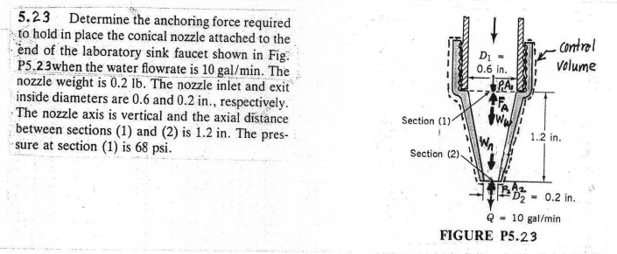
Sample Problem 1

Slide 17
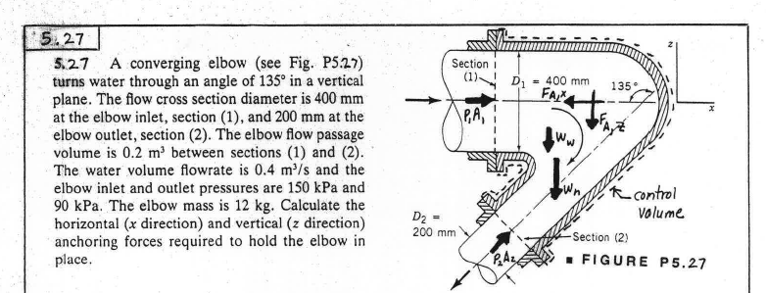
Sample Problem 2

Slide 18
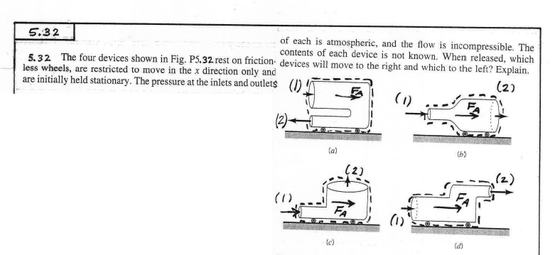
Sample Problem 3

Slide 19
A few comments on linear momentum applications
Linear Momentum is directional (3 components)
If a control surface is selected perpendicular to flow entering or leaving surface force is due to pressure
May need to account for atmospheric pressure
Sign of forces (direction) is very important
On external forces (internal forces cancel out – equal and opposite reactions)

Slide 20
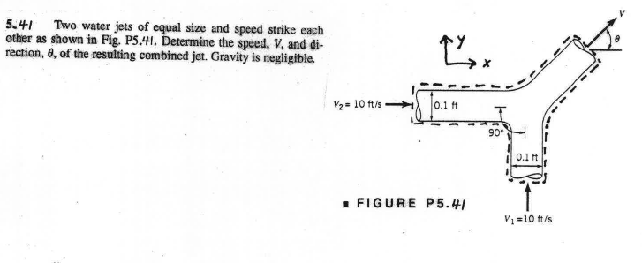
Sample Problem 4

Slide 21
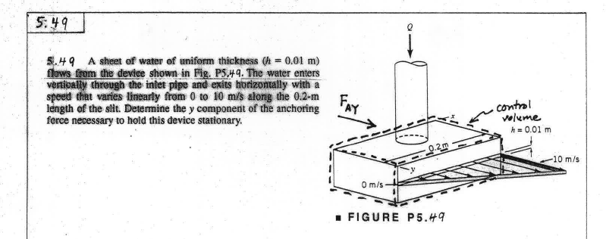
Sample Problem 5

Slide 22
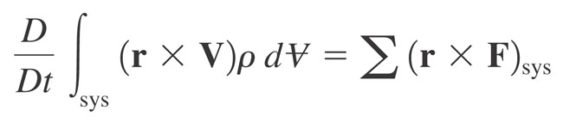
Moment of Momentum
In many application torque (moment of a force with respect to an axis) is important
Take a the moment of the linear momentum equation for a system
Apply Reynolds
Transport Theorem

Slide 23
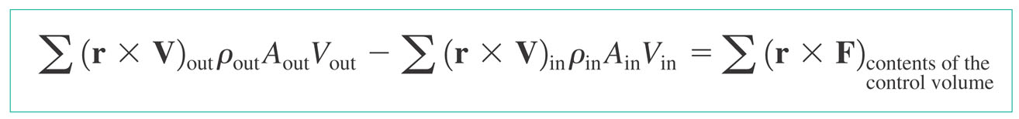
Let’s focus on steady problems
Moment of Momentum Equation for steady flows through a fixed, nondeforming control volume with uniform properties across inlets and outlets with velocity normal of inlets and outlets (more general form available in book Appendix D)
Rotating Machinery

Slide 24
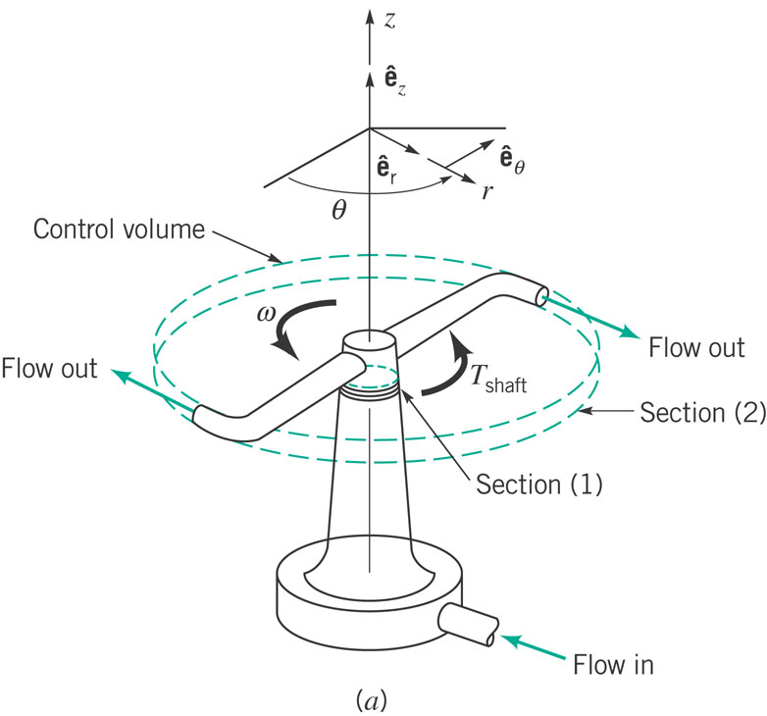
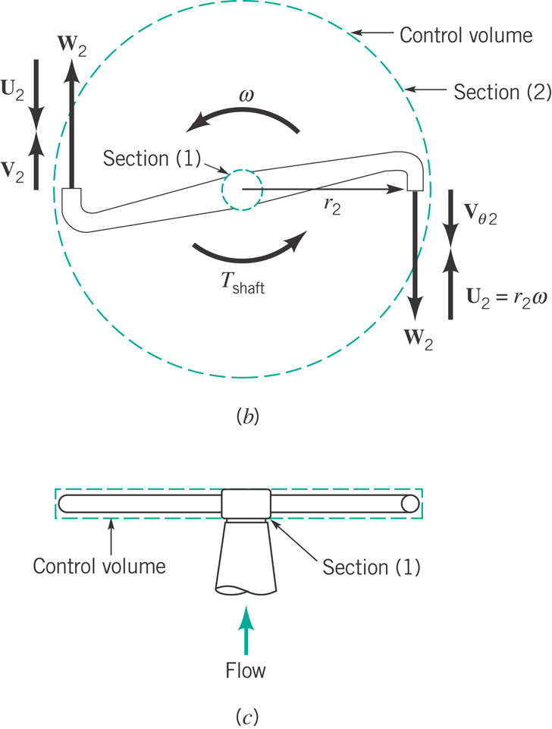
Application (from textbook)

Slide 25
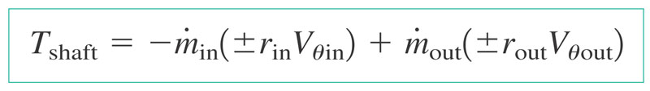
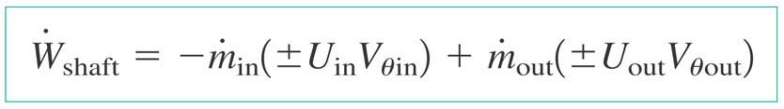
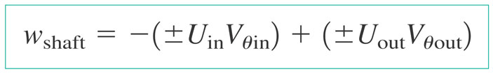
Moment of Momentum Formulas
Torque
Power
Work per Unit Mass

Slide 26
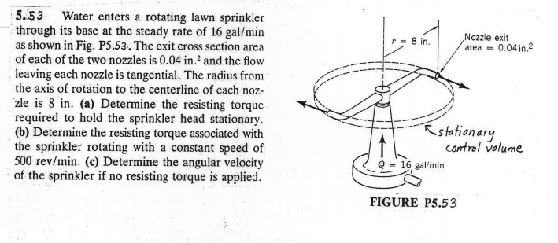
Sample Problem 1

Slide 27
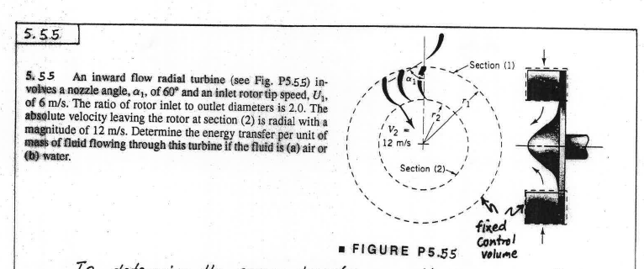
Sample Problem 2

Slide 28
Conservation of Energy First Law of Thermodynamics
Same principles as for all conservation laws
Time rate of change of total energy stored
=
Net time rate of energy addition by heat transfer
+
Net time rate of energy addition by work transfer
We go through the same process transferring system to control volume by Reynolds Transport Theorem

Slide 29
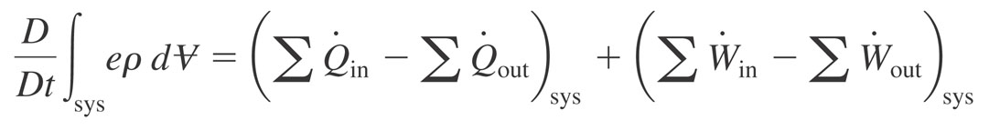
Mathematically Speaking
First Law of Theromodynamics
A few definitions
Adiabatic – heat transfer rate is zero
Power – rate of work transfer W
.

Slide 30


Power – comes in various forms
For a rotating shaft
For a normal stress (Force x Velocity)

Slide 31
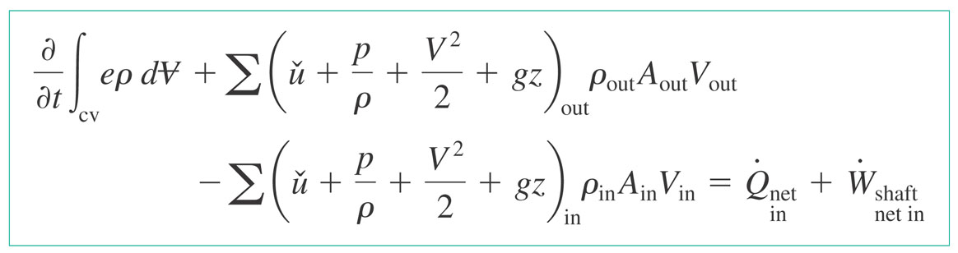
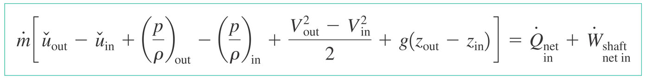
For application purposes
OR for steady flow….
Internal energy, enthalpy, kinetic energy, potential energy

Slide 32
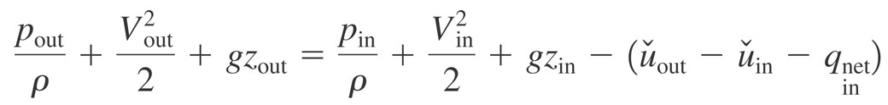
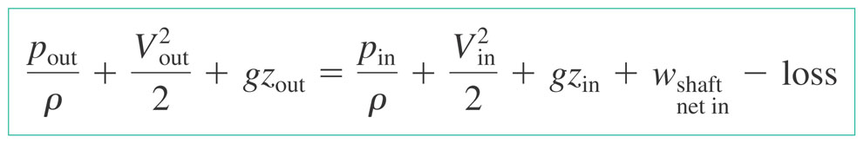
Comparison to Bernoulli’s Eqn
For steady, incompressible flow with zero shaft power
Include a source of energy (turbine, pump)
If this is zero – identical
Often treated as a correction
Factor called ‘loss’

Slide 33
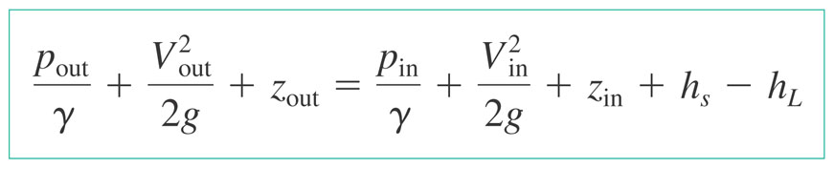
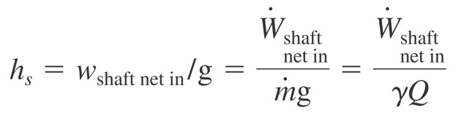
Or in terms of head

Slide 34
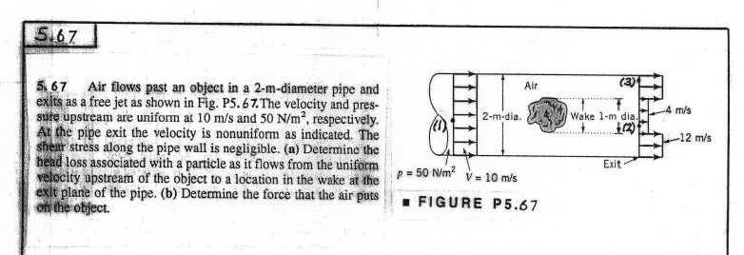
Sample Problem 1

Slide 35
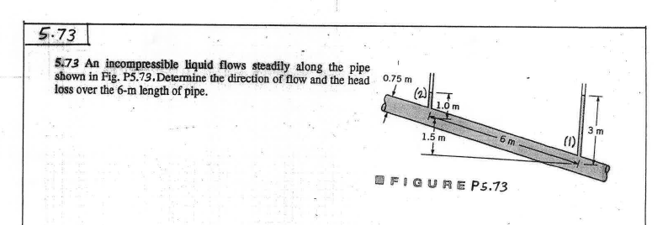
Sample Problem 2

Slide 36
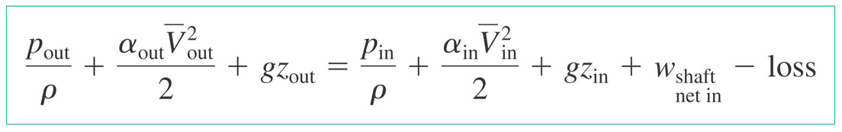
Application of Energy Equation to Nonuniform Flows
Modified energy Equation
α – kinetic energy coefficient
α = 1 for uniform flows,
α > 1 for nonuniform (tabulated, many practical cases
α ~1) – in this course will be given

Slide 37
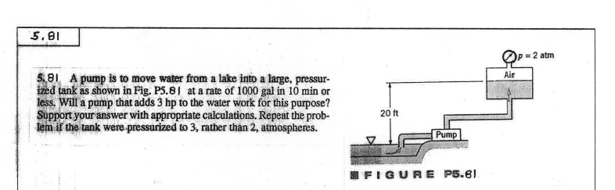
Sample Problem 1

Slide 38
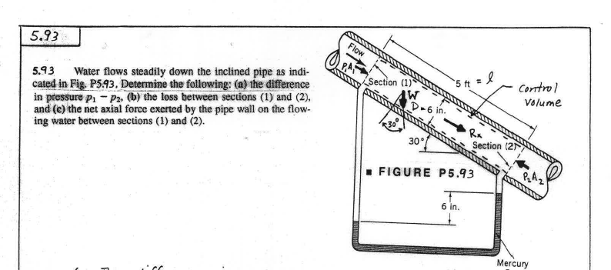
Sample Problem 2

